Slide 1
Te Huataki – Picture Cards
Here are some activities that use the picture cards to explore learning and retelling of the story.
Sequence the story. Discuss what happened at the beginning, the middle and the end of the story. Select one or a few picture cards to prompt retelling about the story. Make a class book, retelling the story. What did you like? What didn’t you like? What would you change? | Select a picture card and describe what is happening in it. What happened before this? What happens after? Play ‘what am I?’ ‘Who am I?’ Describe the characteristics of a character. Share ideas about the setting, the characters and the main ideas from the story.

Slide 2
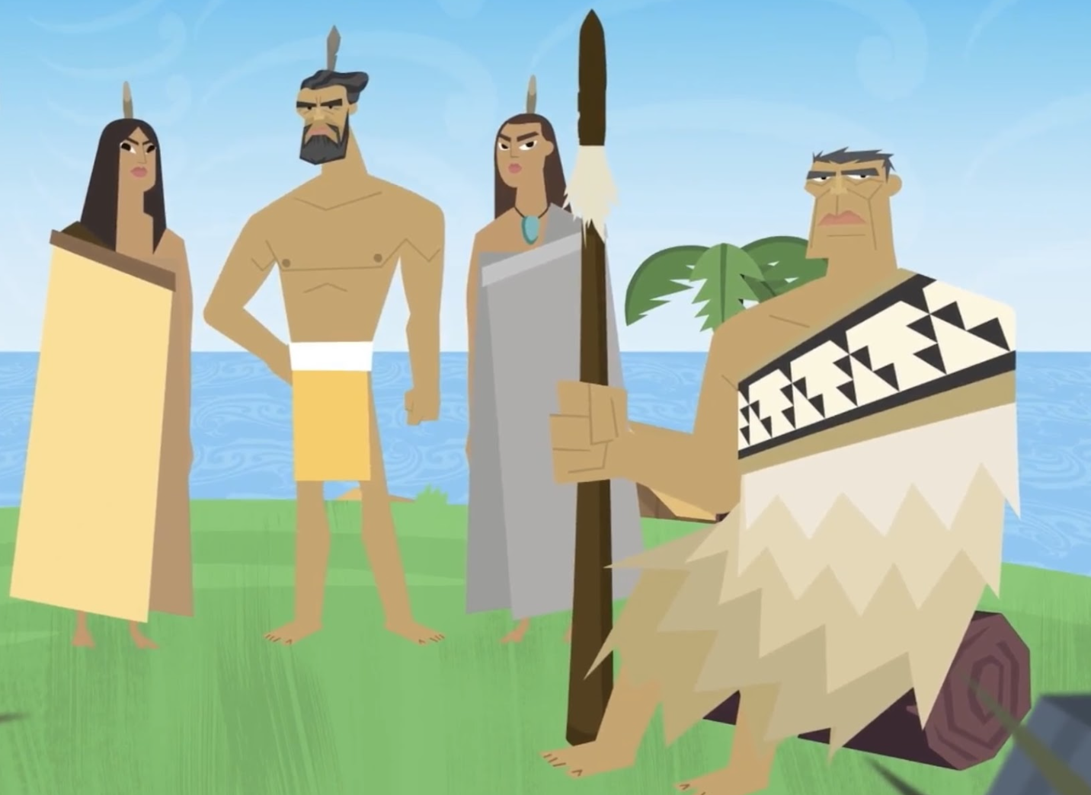
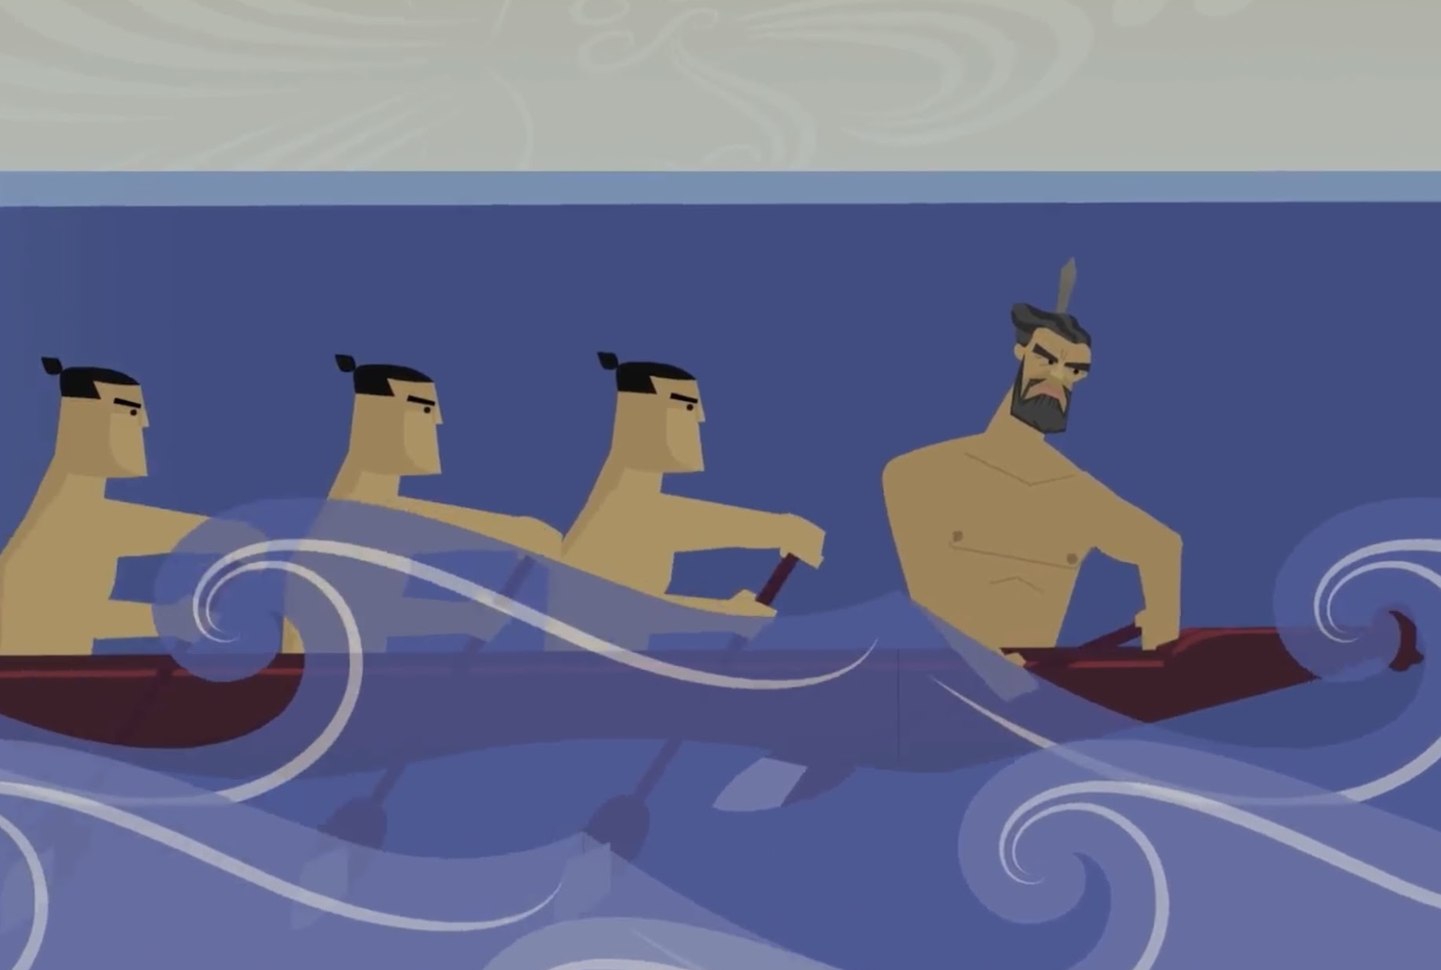
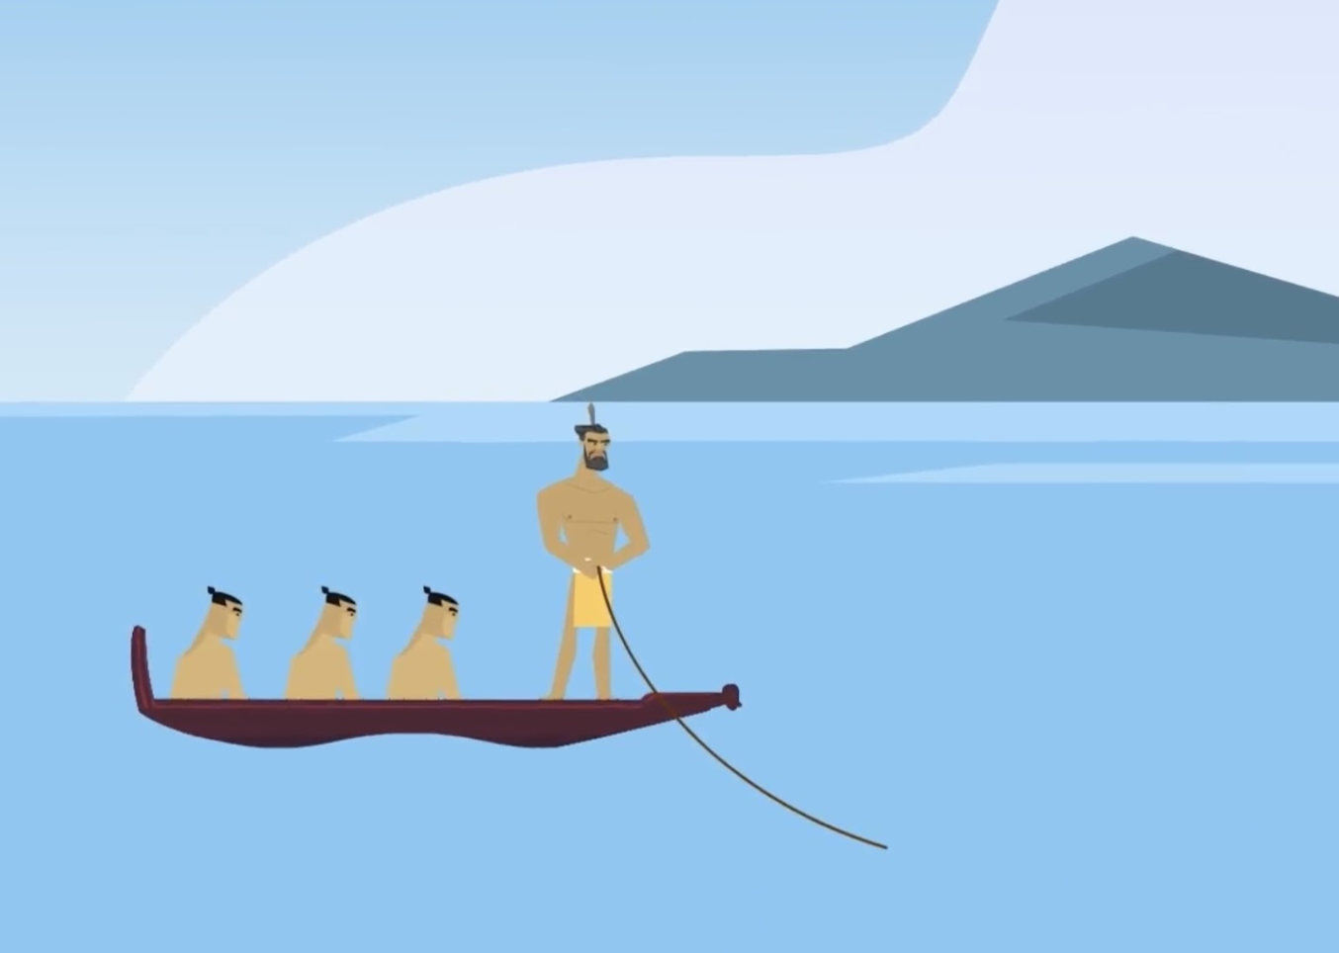
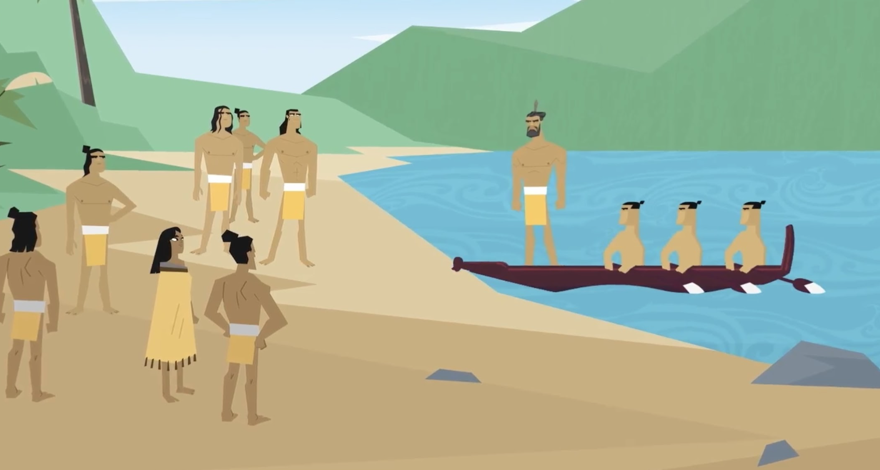

Slide 3
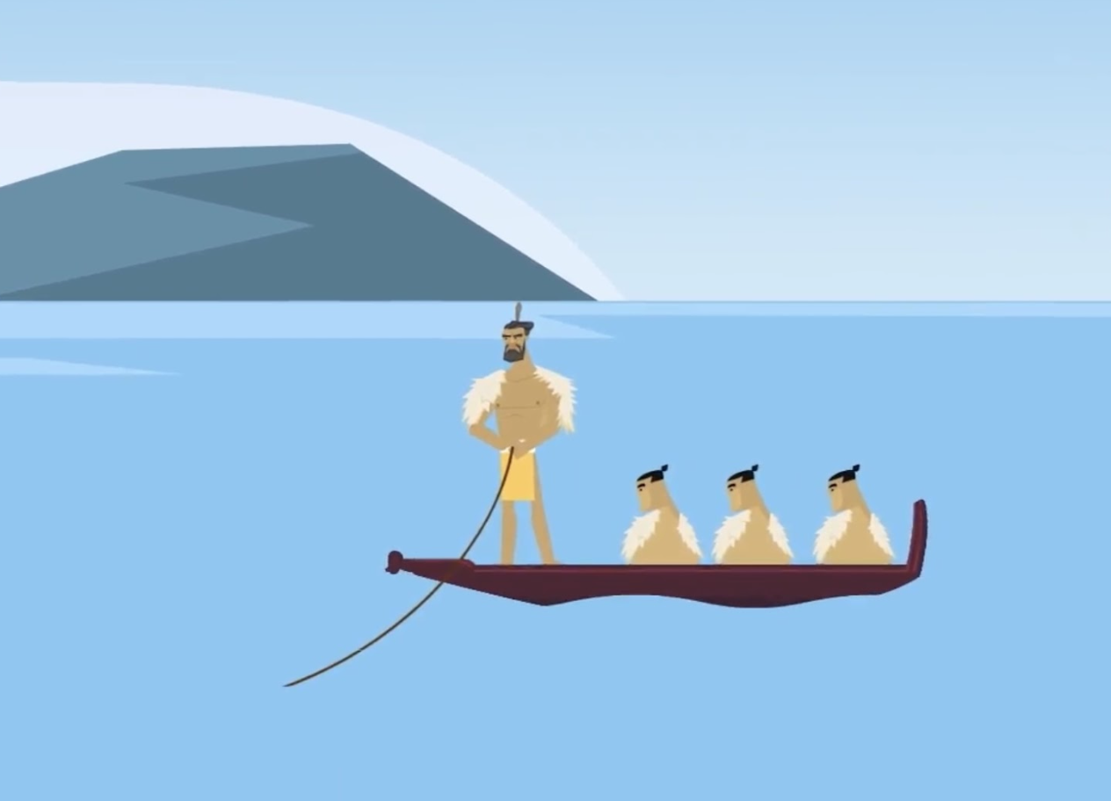
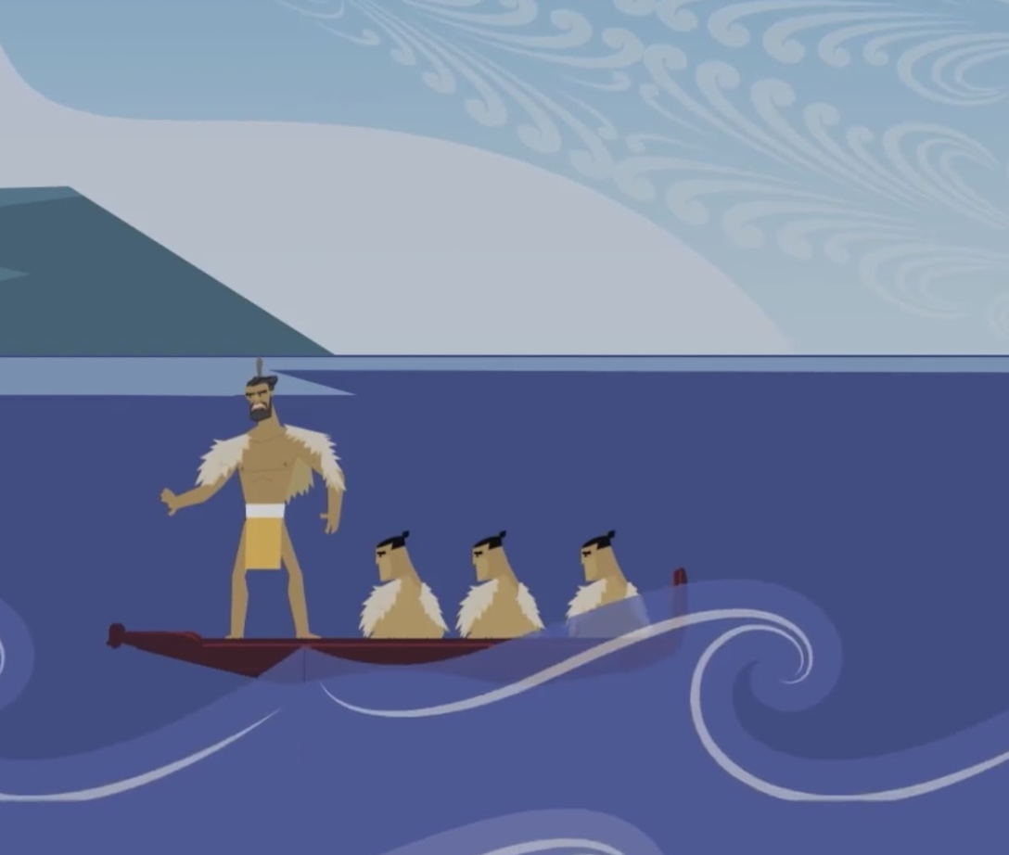
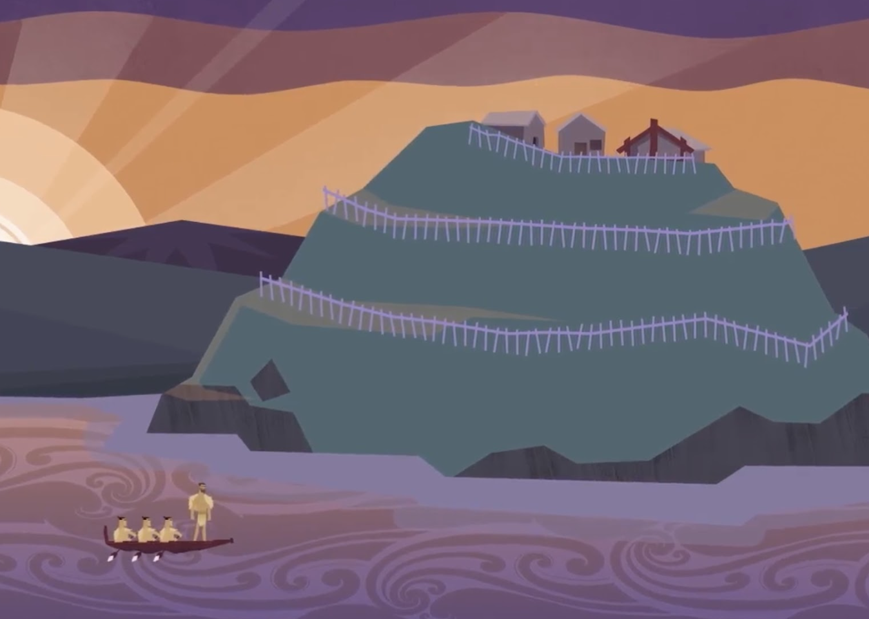
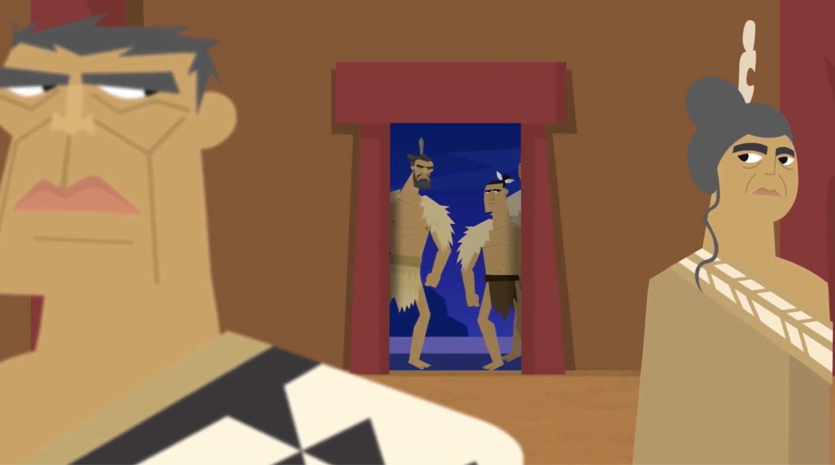

Slide 4
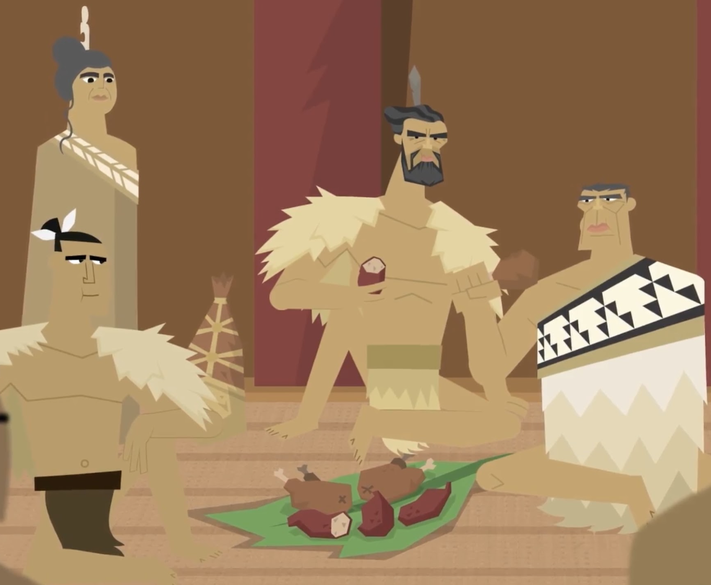
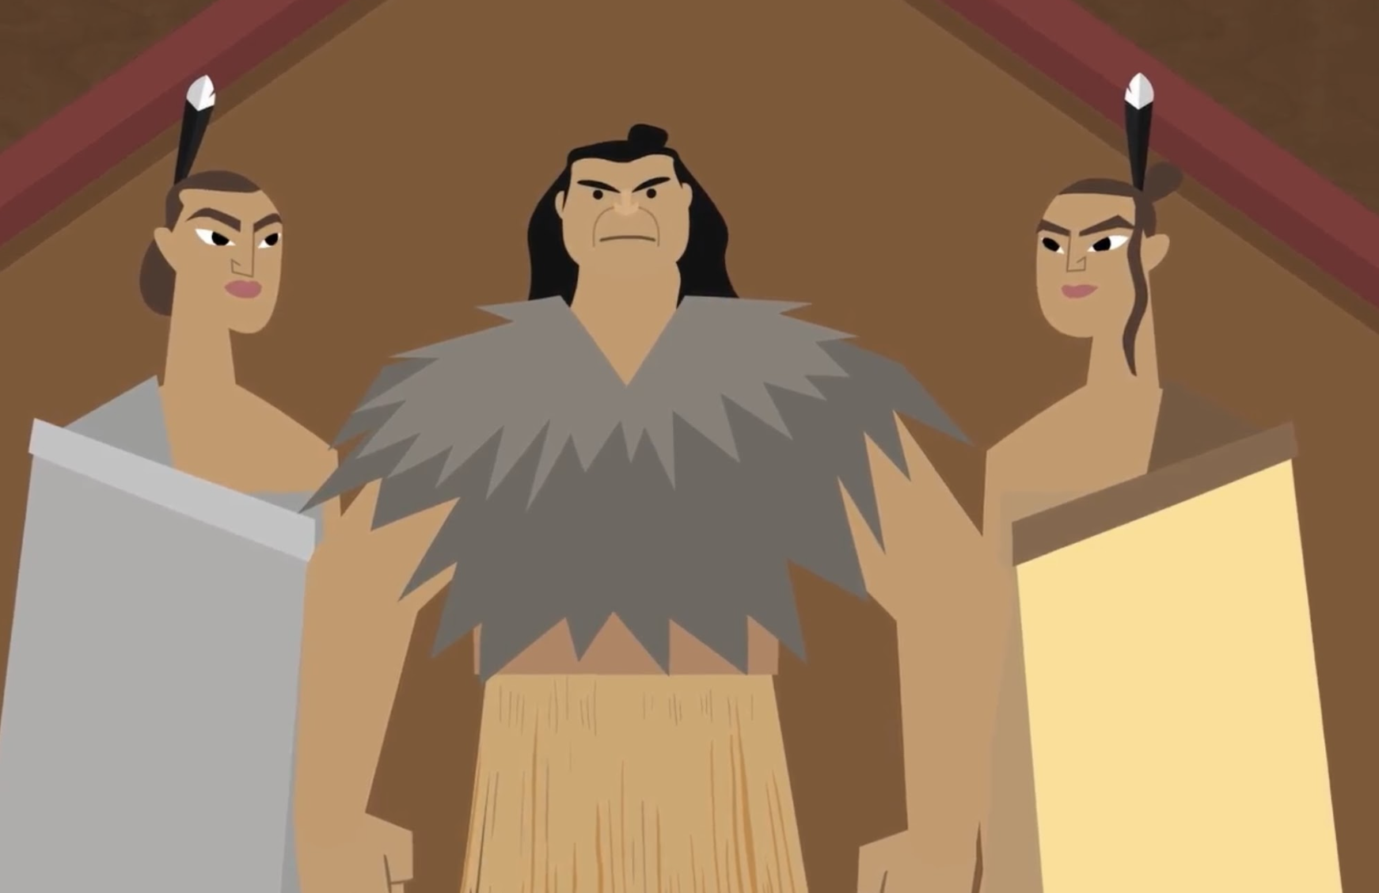
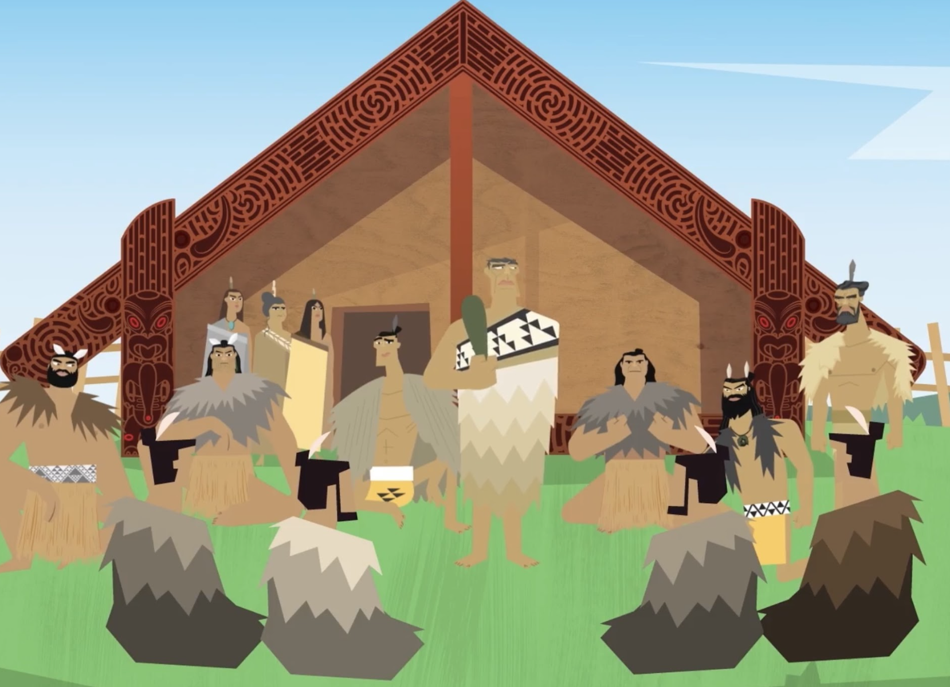
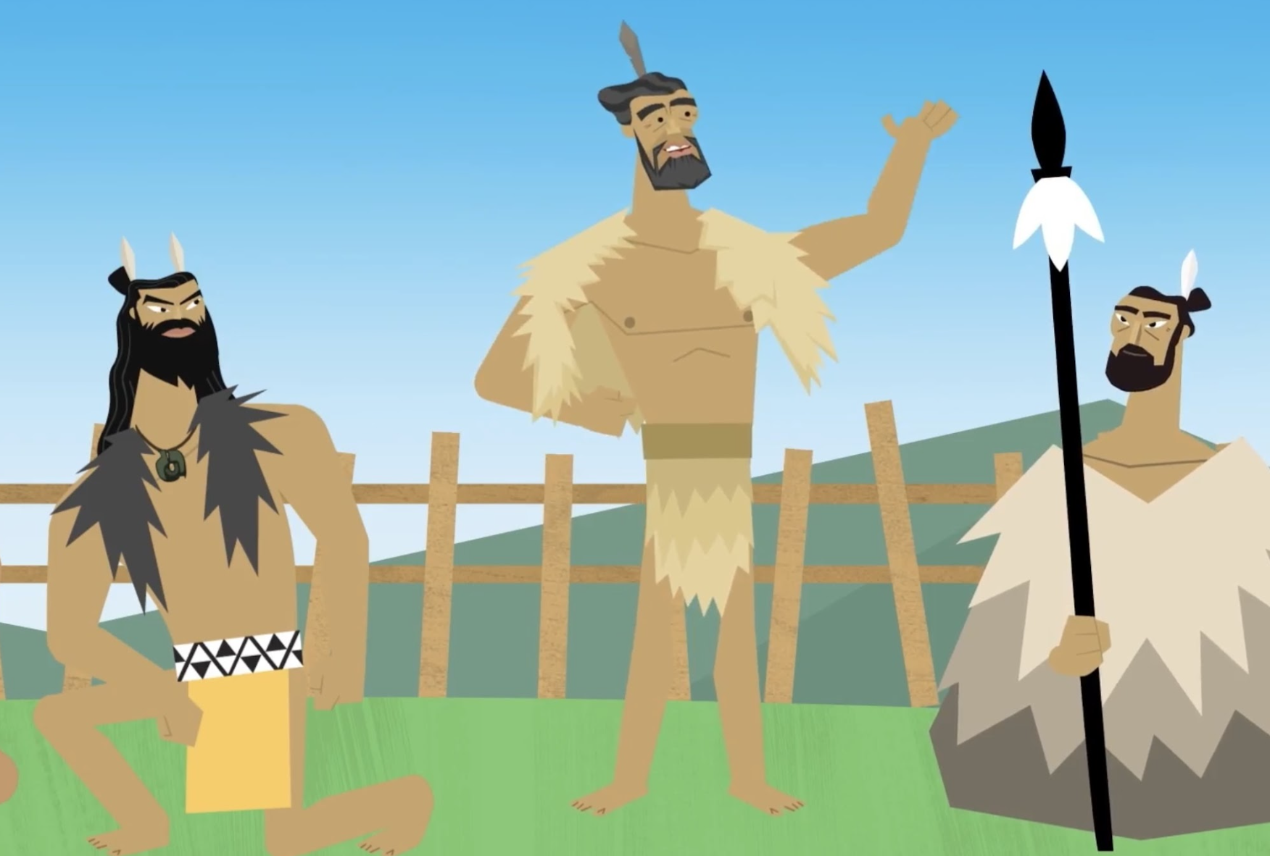

Slide 5
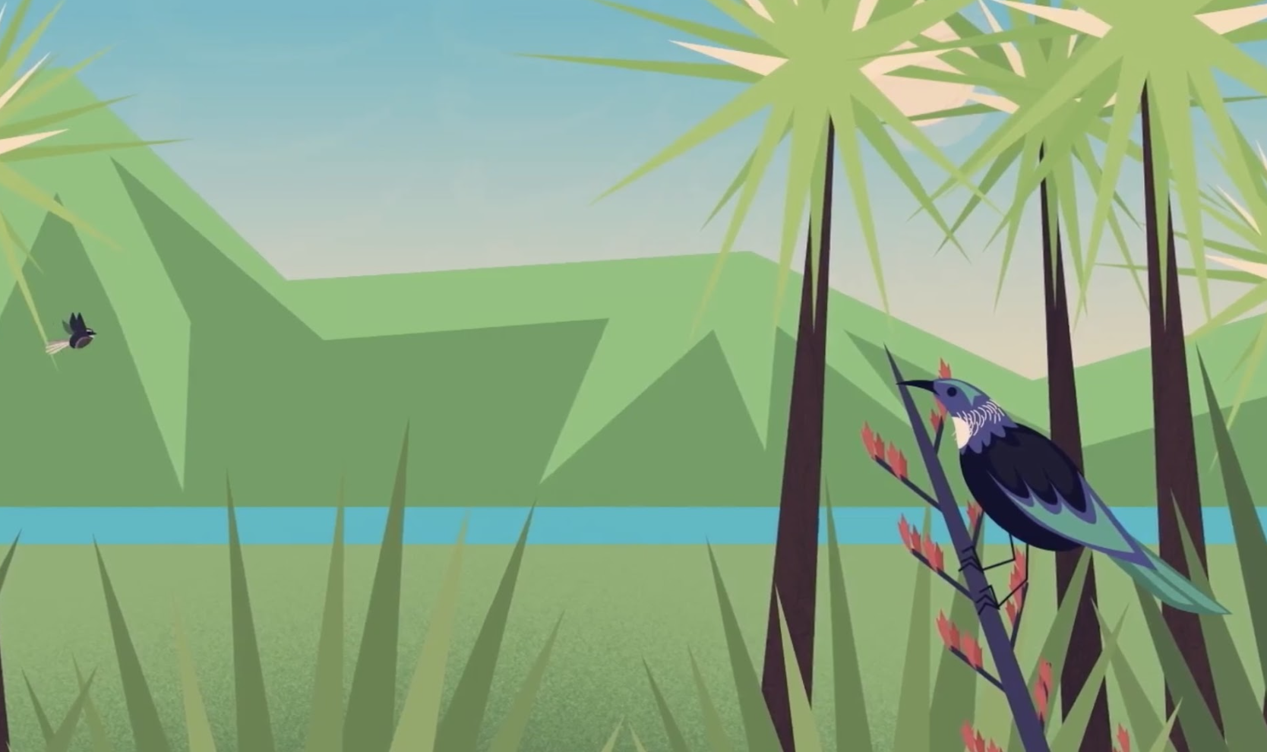
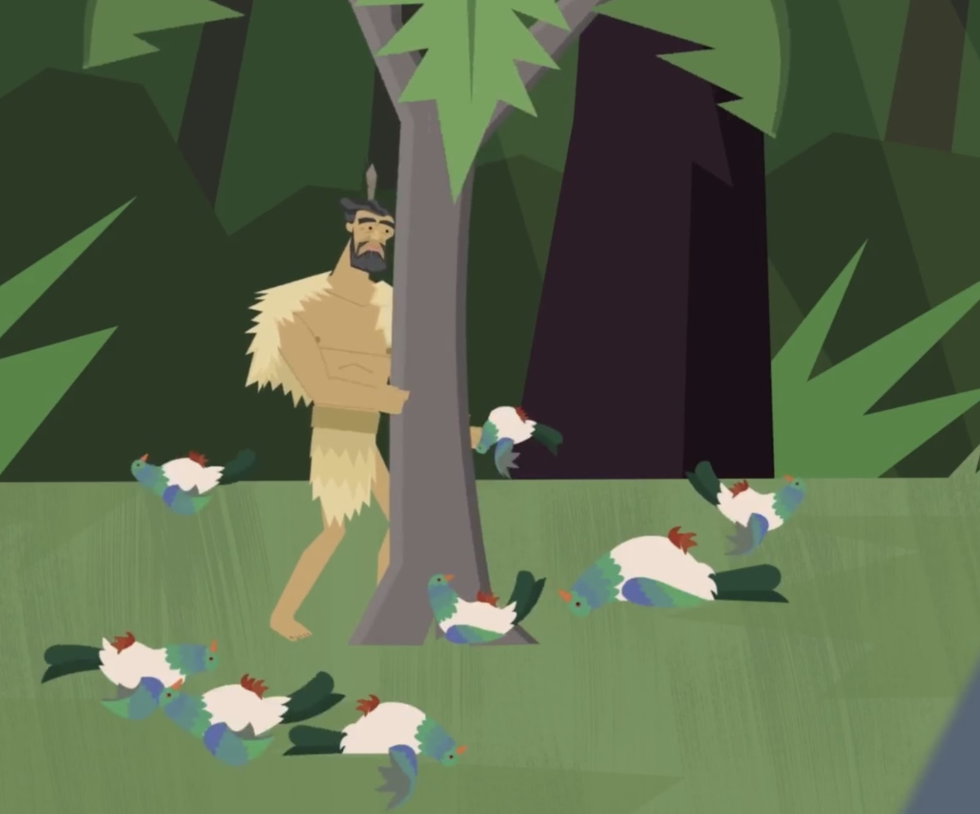
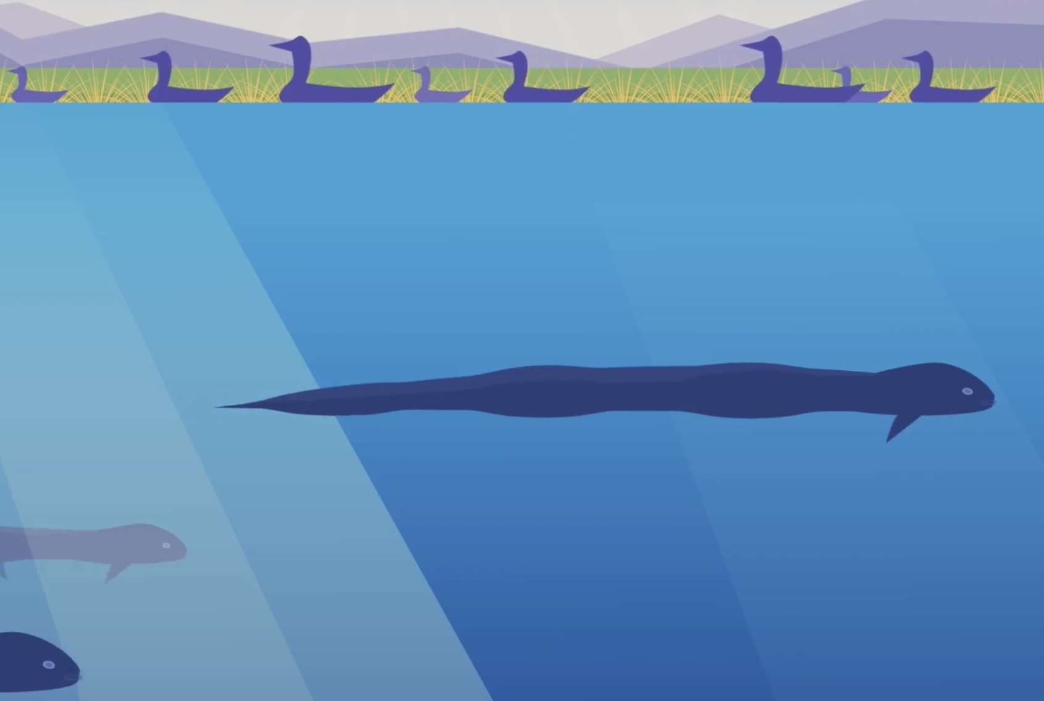

Slide 6
