Slide 1
Hinerongo & Tūteurutira
PICTURE CARDS
Here are some activities to make use of the flash cards to explore learning and retelling of the story.
Sequence the story. Discuss the beginning, the middle and what happened at the end of the story. Select one or a few picture cards to prompt retelling about the story. Make a class book, retelling the story. What did you like? What didn’t you like? What would you change? | Describe what is happening in the picture. What happened before this? What happens after? Play ‘what am I?’ ‘Who am I?’ Describe the characteristics of a character. Share ideas about the setting, the characters, the main ideas from the story.

Slide 2
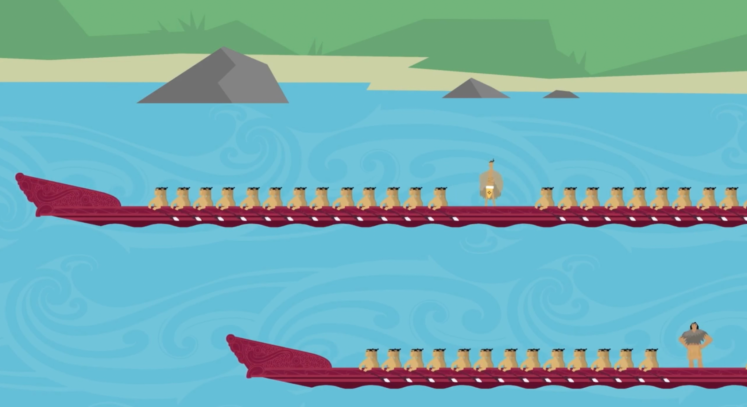
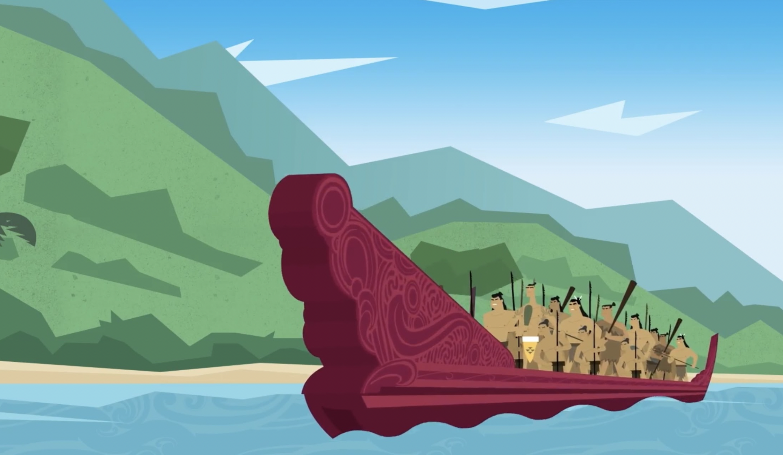

Slide 3
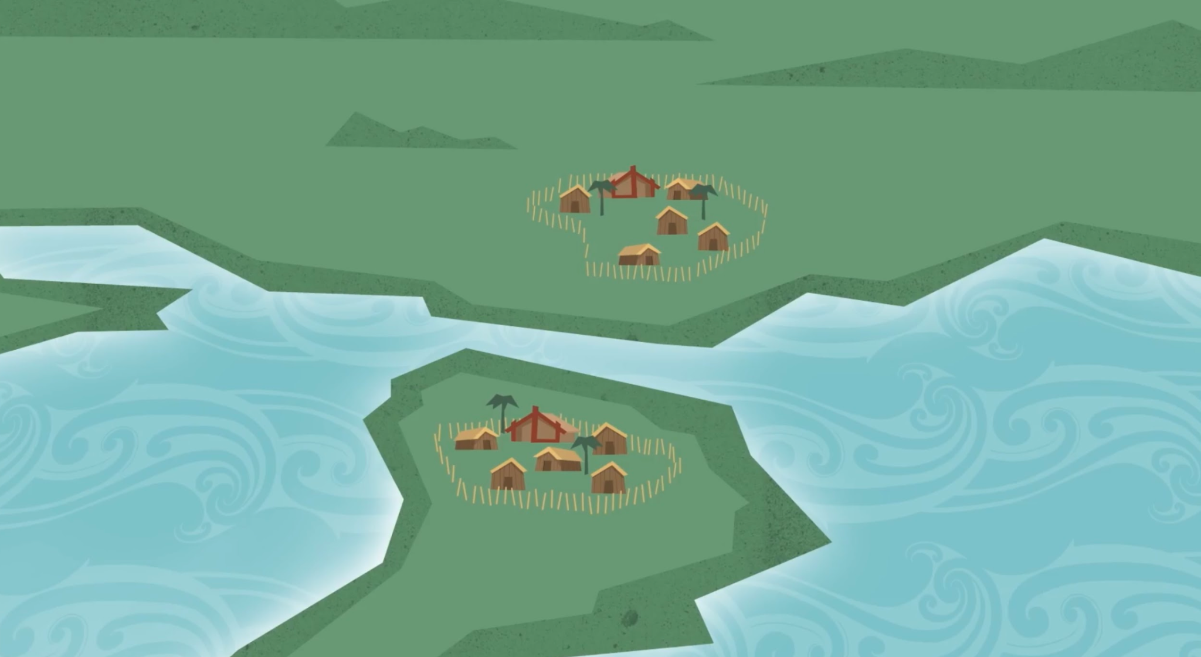
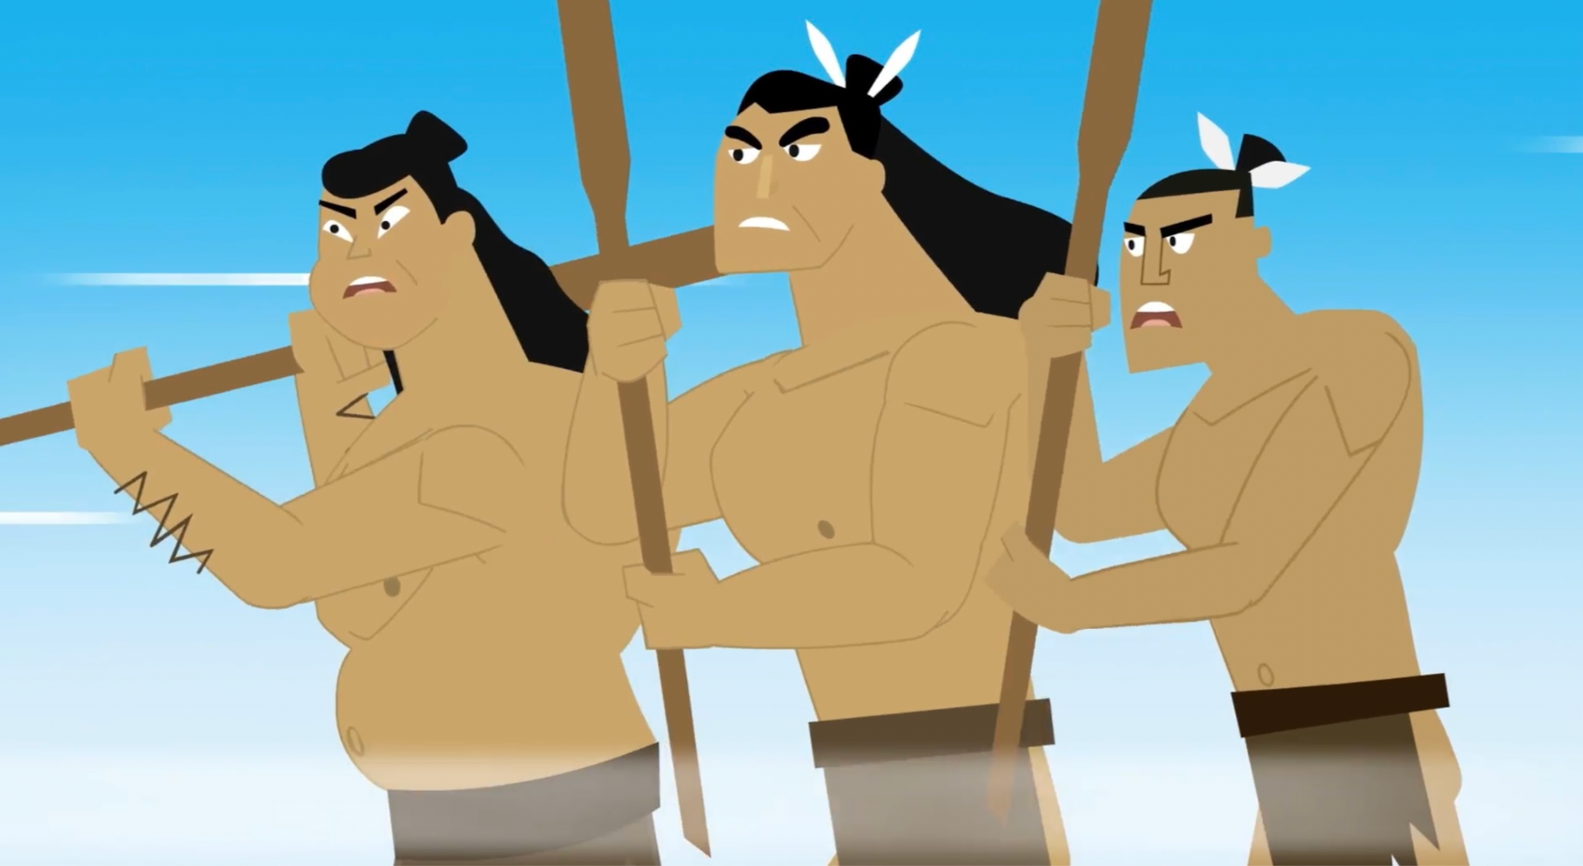
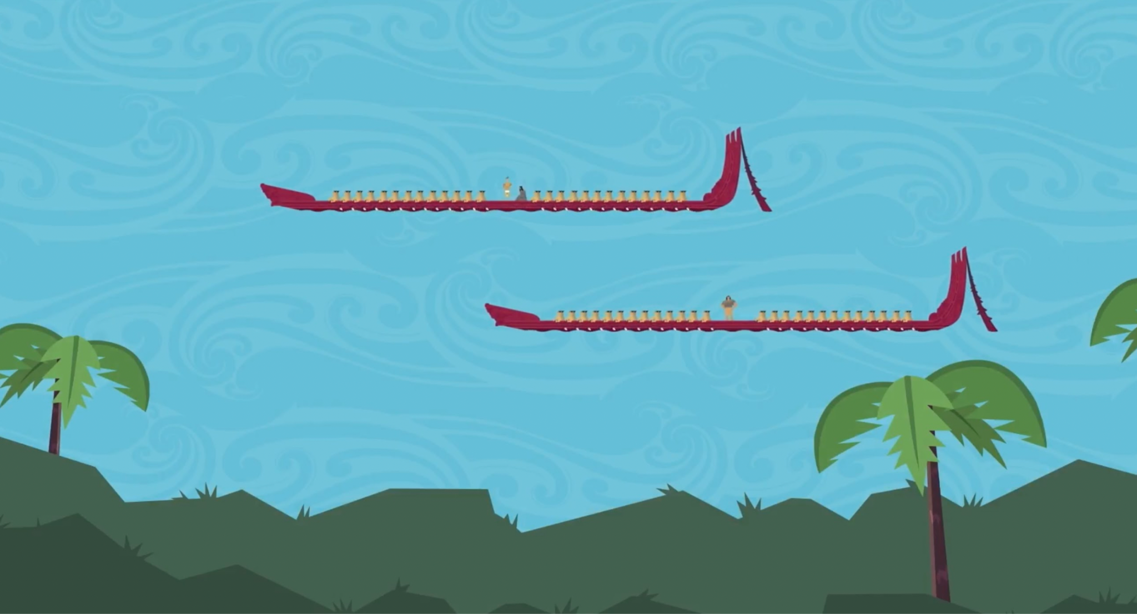
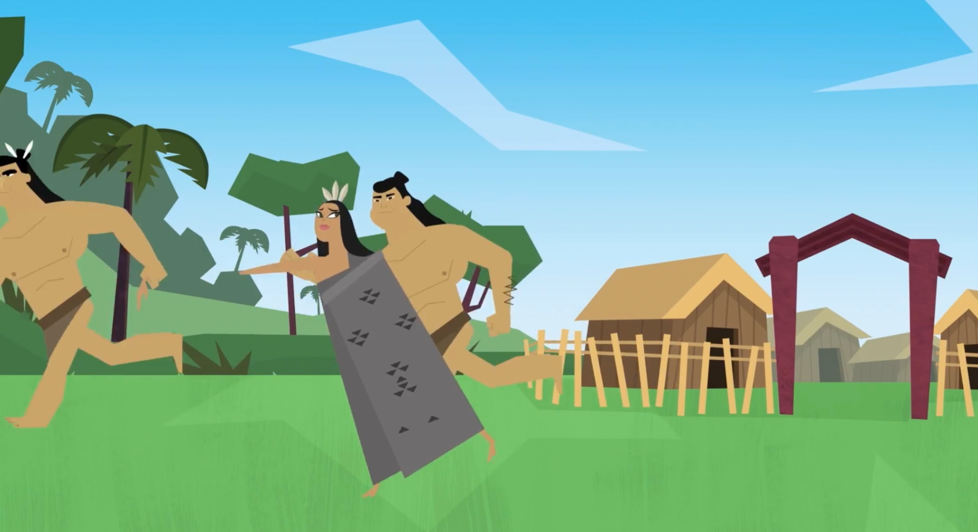

Slide 4
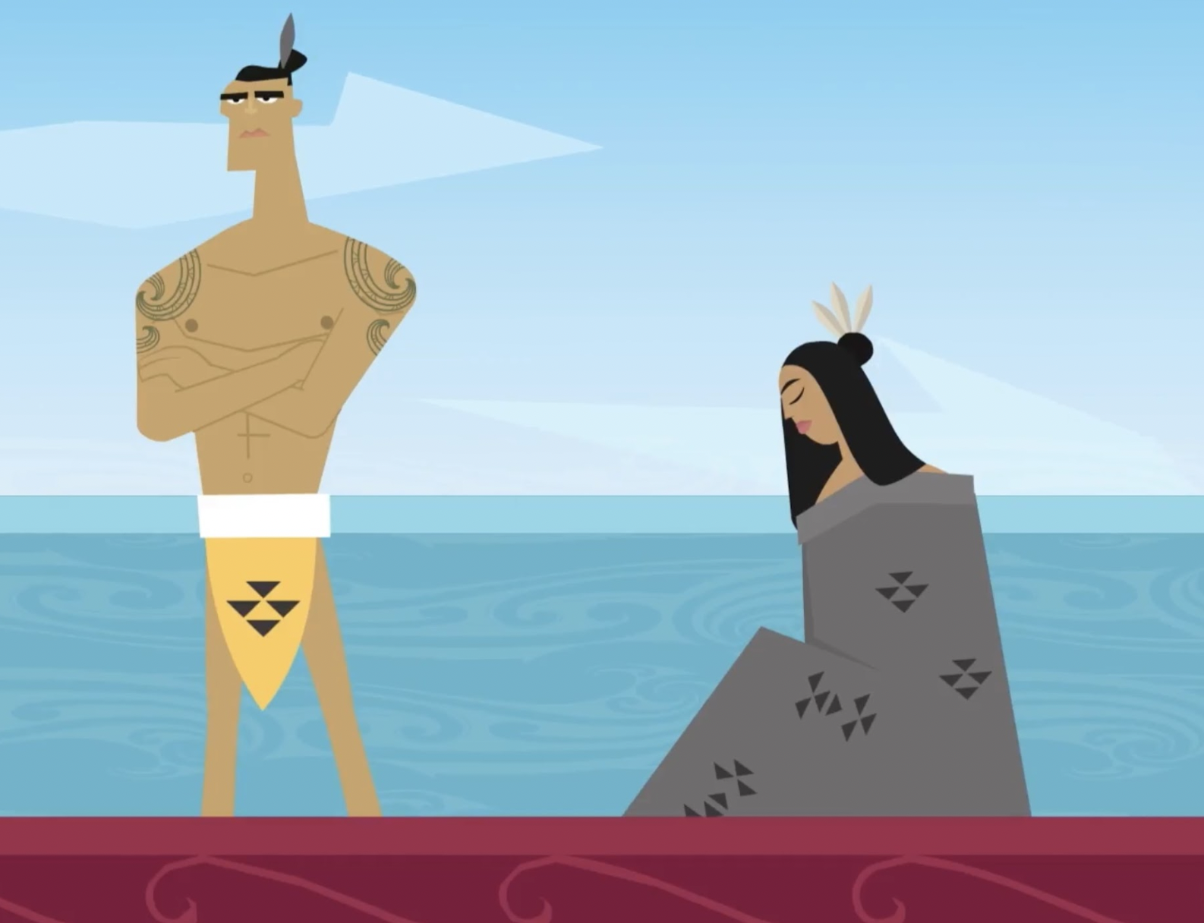
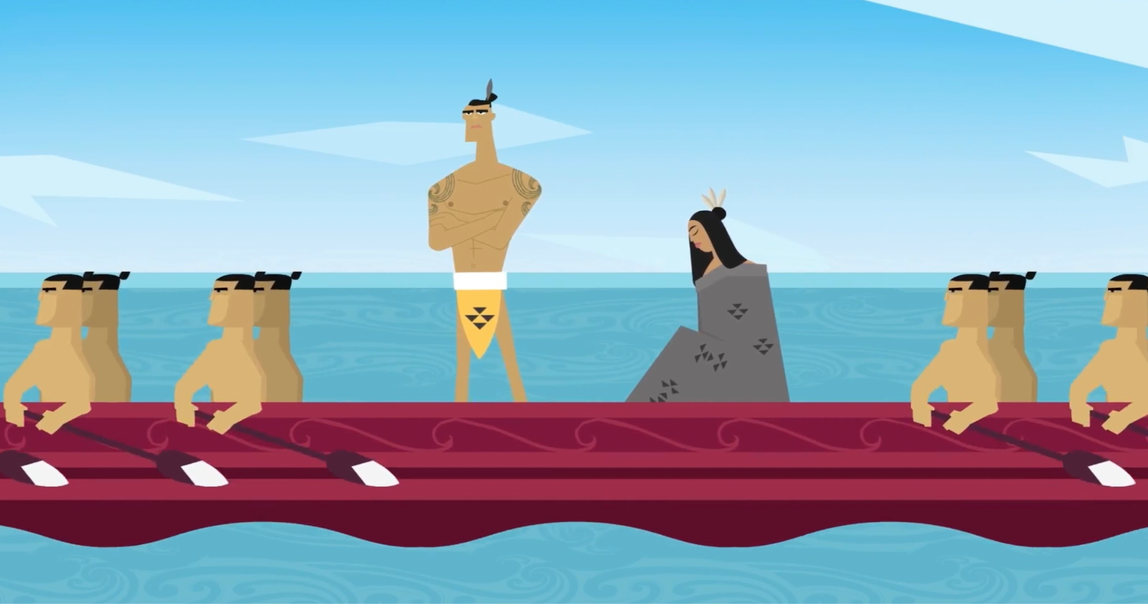
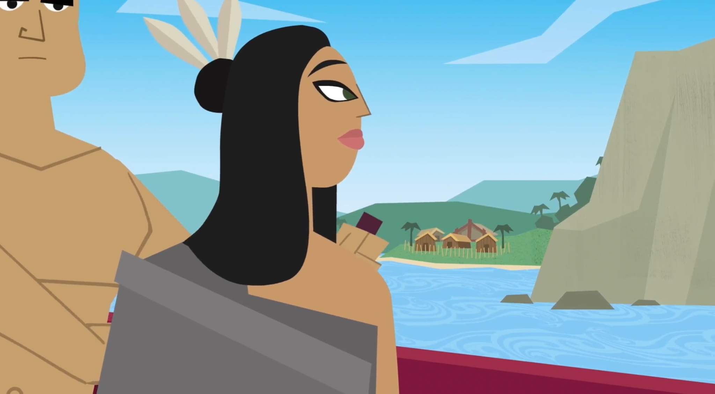
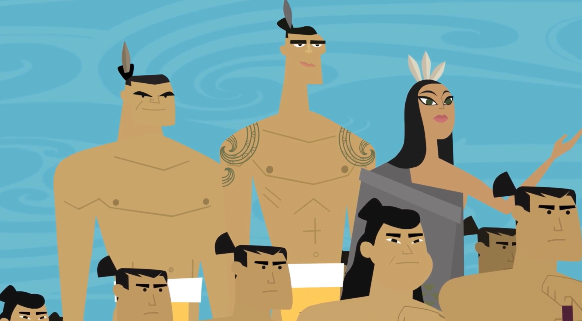

Slide 5
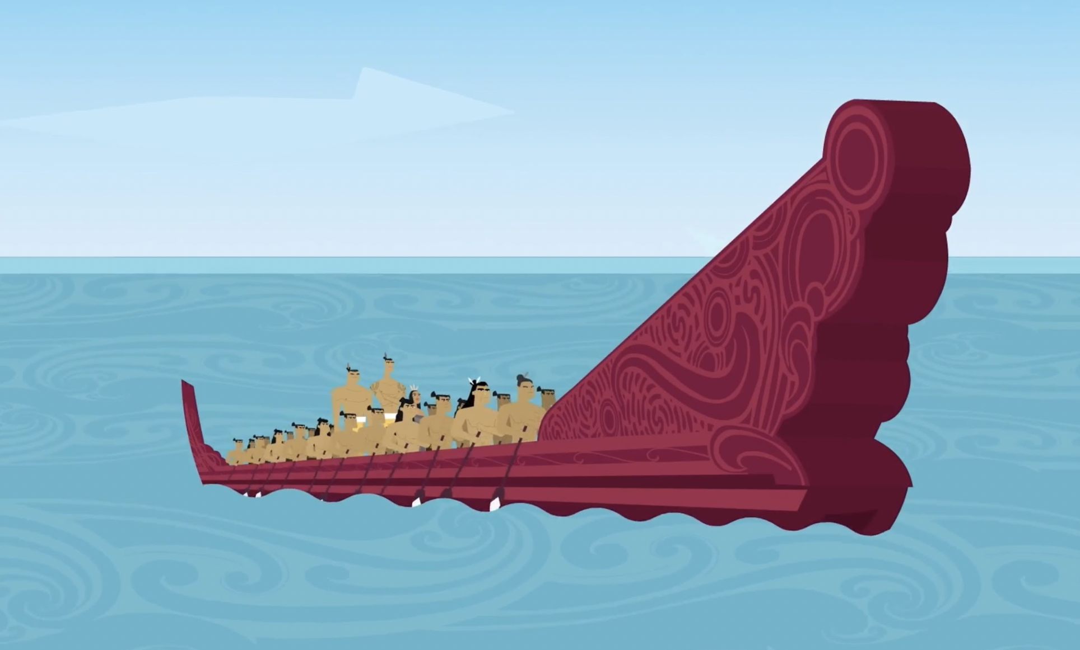
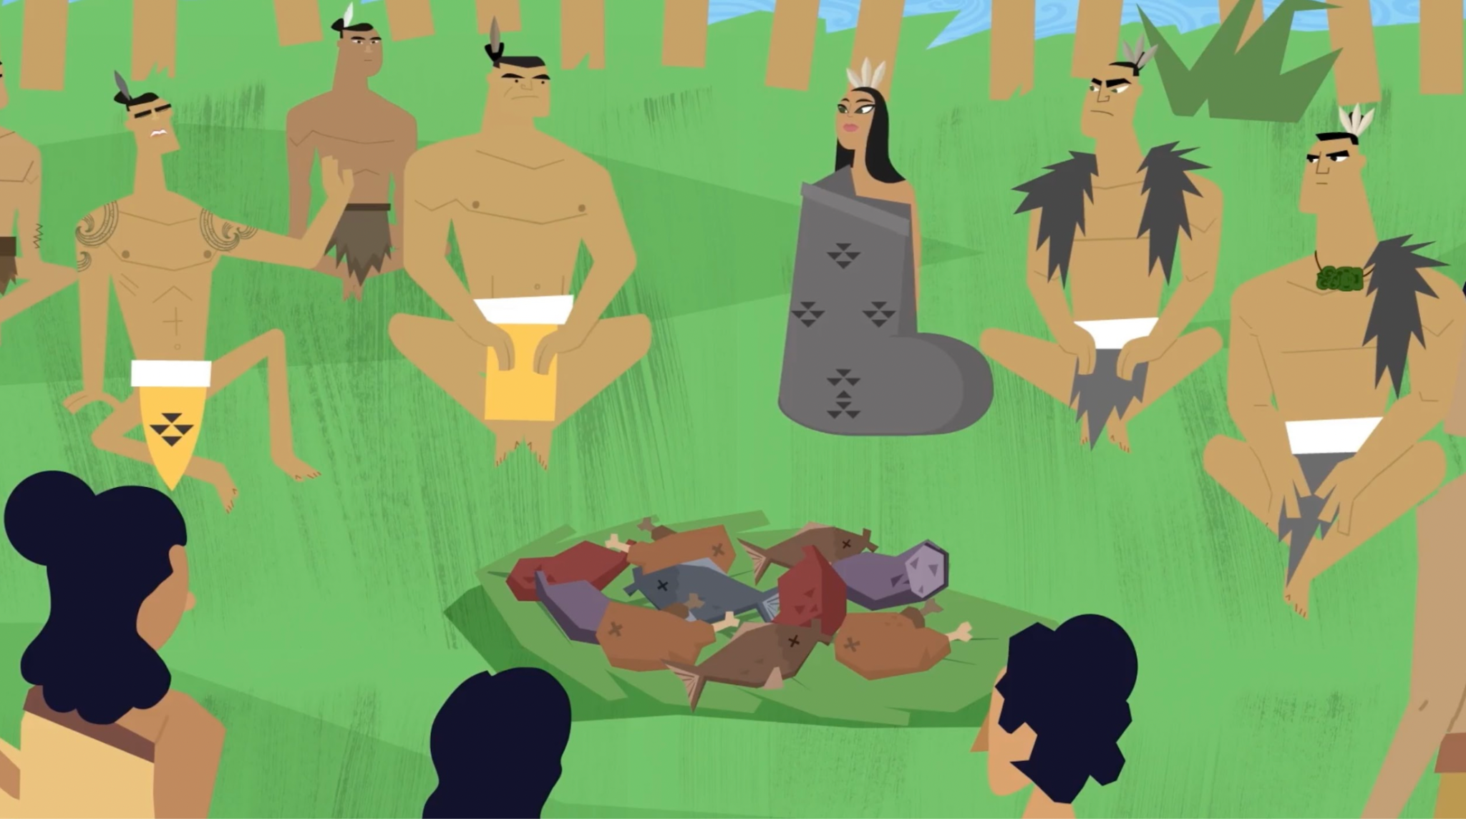
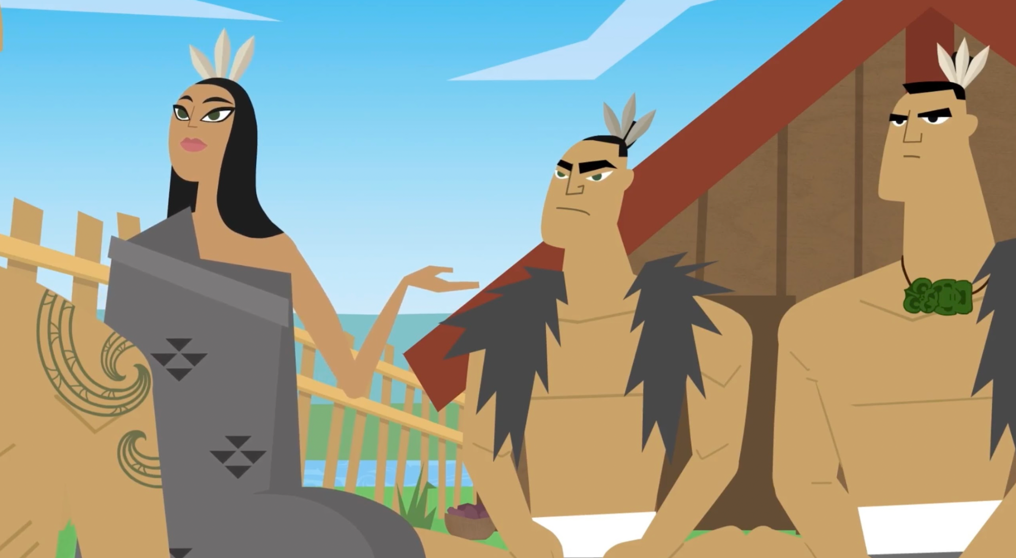
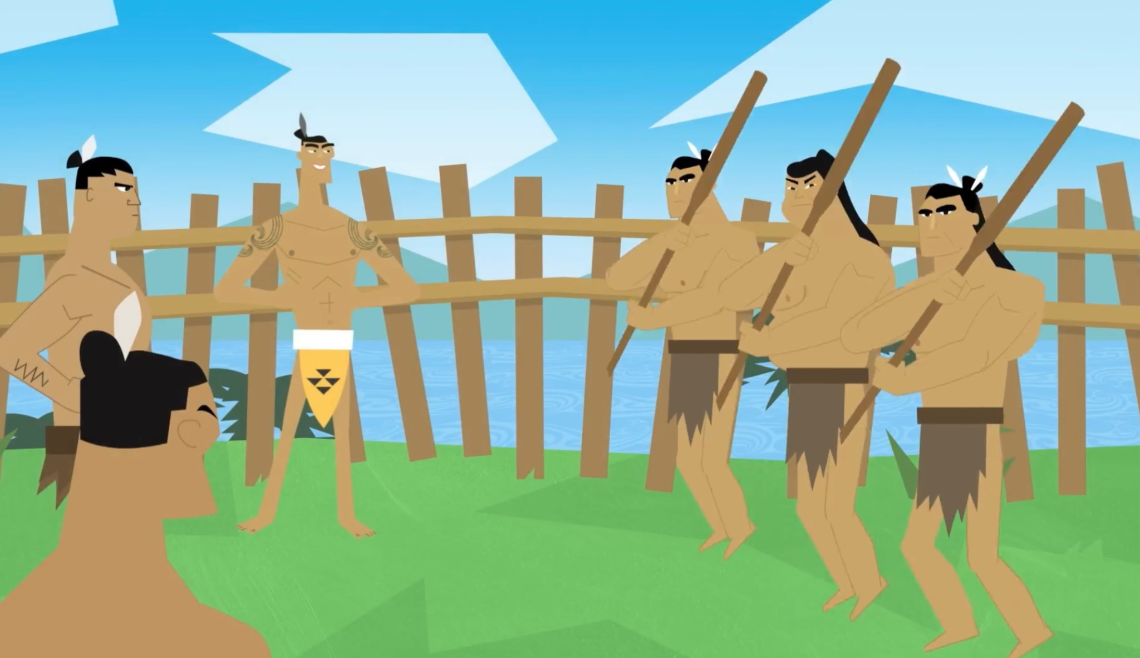

Slide 6
