Slide 1
Nōku Te Kori, Kia Kori Mai Hoki Koe
Let me make the first move and follow me carefully
Nā Marukaitātea
Objectives These cards are designed to support ākonga to move, take action. Learn Marukaitātea’s whakatauākī “Nōku te kori, kia kori mai hoki koe”. Have an ākonga lead with an action and the others copy and follow along. Decide and set your own rules to make this activity enjoyable. Create a tiki toki dance, a game or sport warm up. The point is for one to lead and model and others to imitate the movements. Stand in a circle as a group and get one tamaiti to show an action. Everyone else copies this movement, then the next tamaiti does a different action to make and add to a sequence. | Instructions Print the kori cards on firm card. Choose how many cards to select, as a start. We suggest five. Carefully look at the action on the card. Lay out the cards that will be your korikori / action sequence Create a beat or sing a tune to support and go along with the movements. Add a sound to accompany the action or follow up the action. For example, You jump then say ‘hī’, clap and say ‘hā’. There are loads of possibilities. Create new korikori action movements.

Slide 2
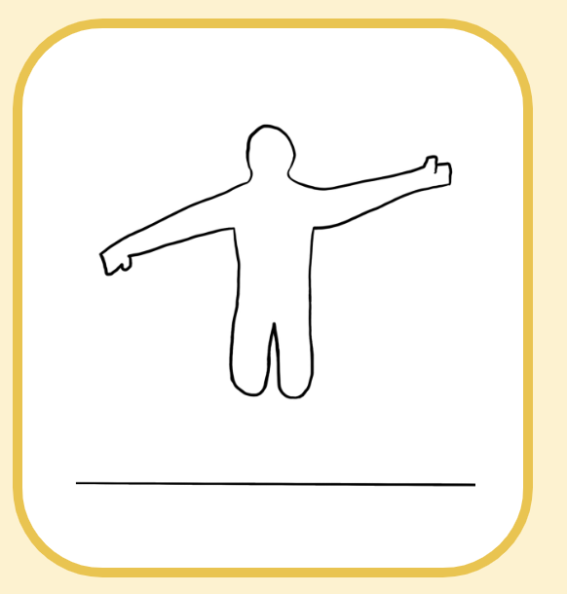
Example
1 | 2 | 3 | 4 | 5

Slide 3
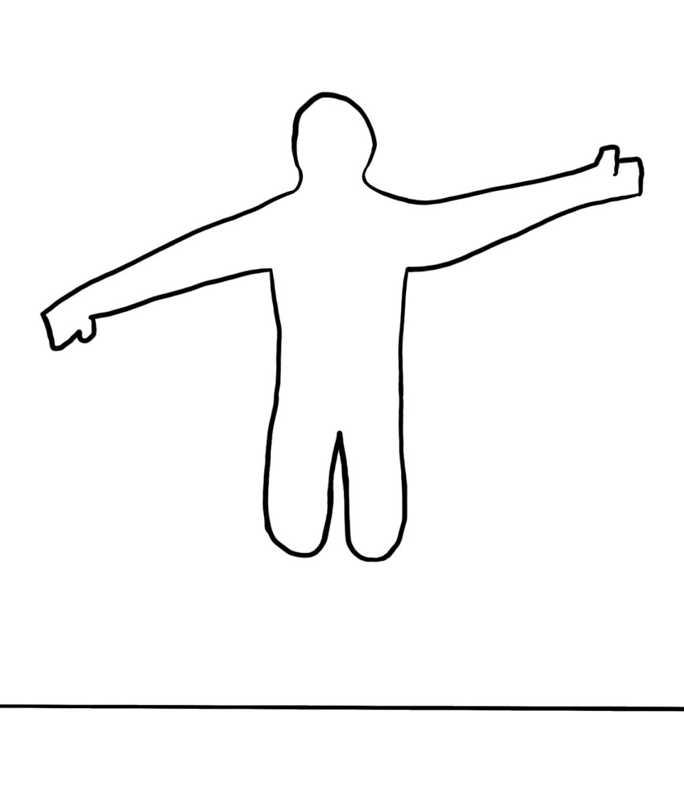
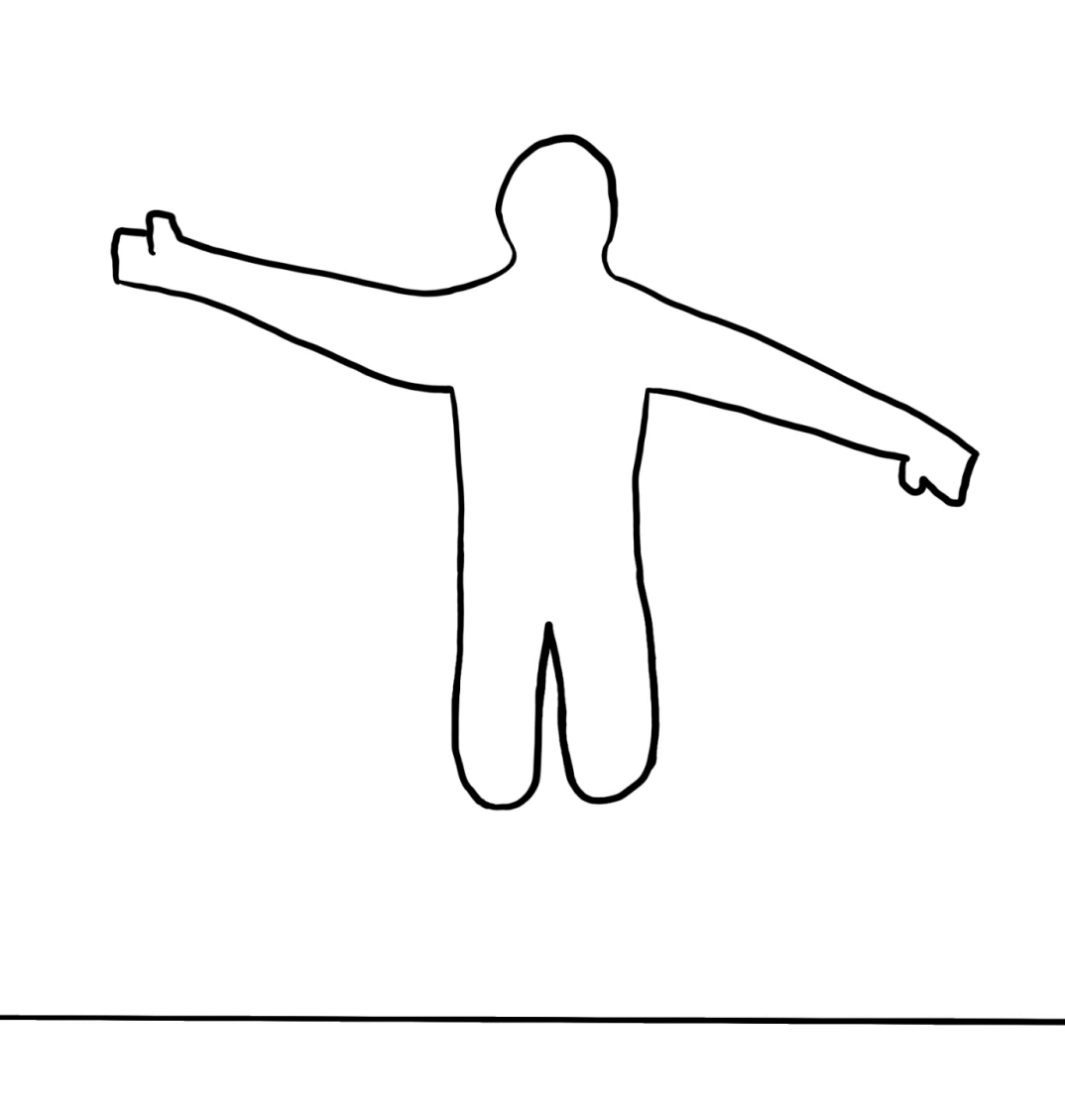

Slide 4
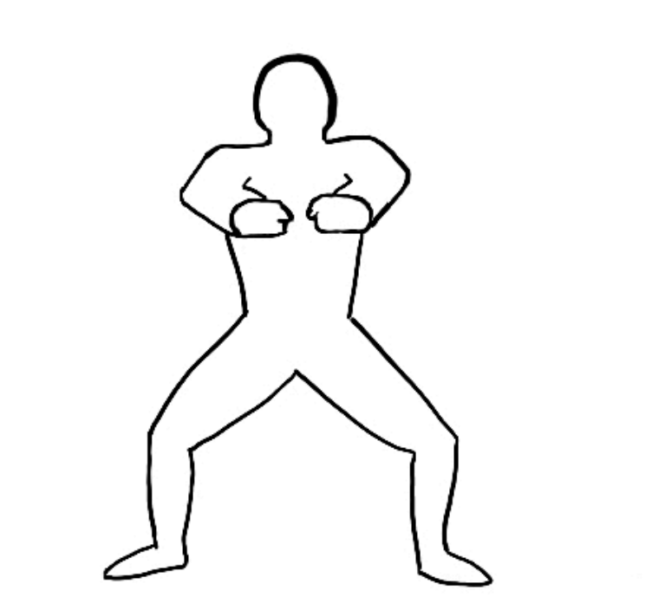
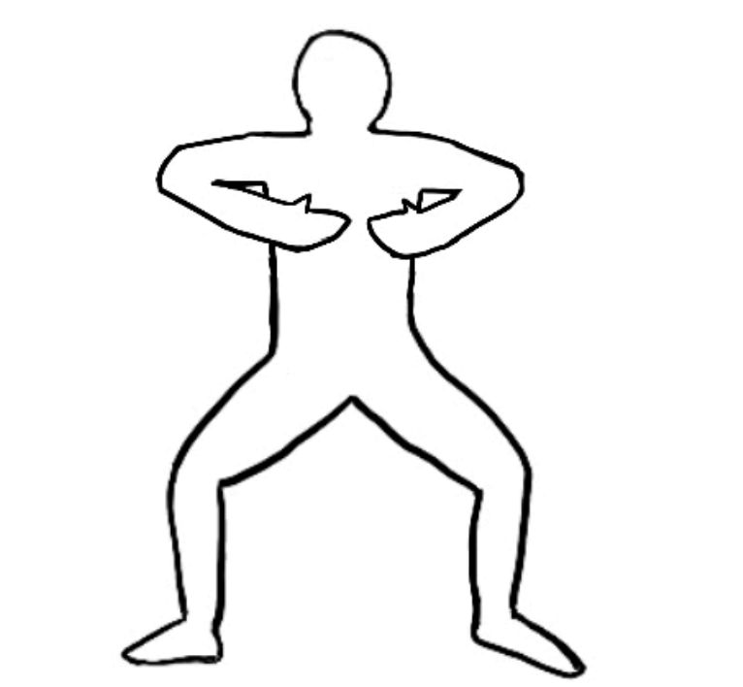

Slide 5
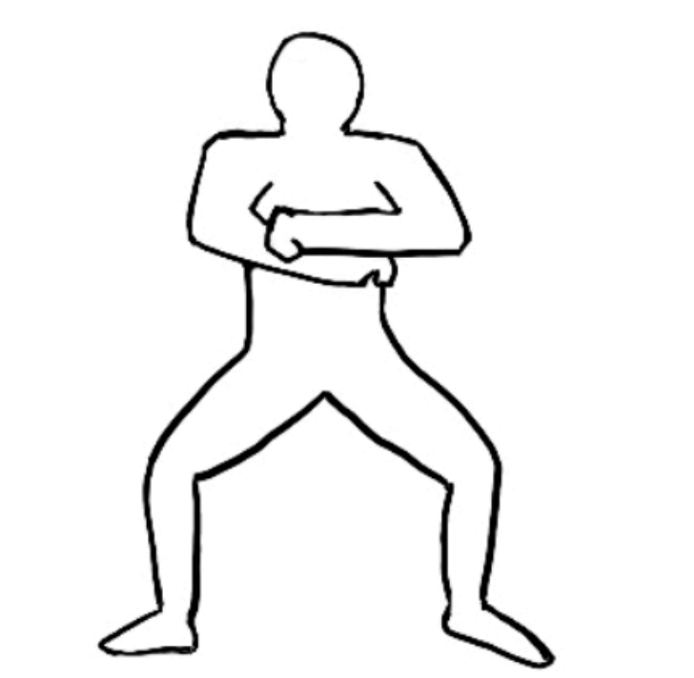
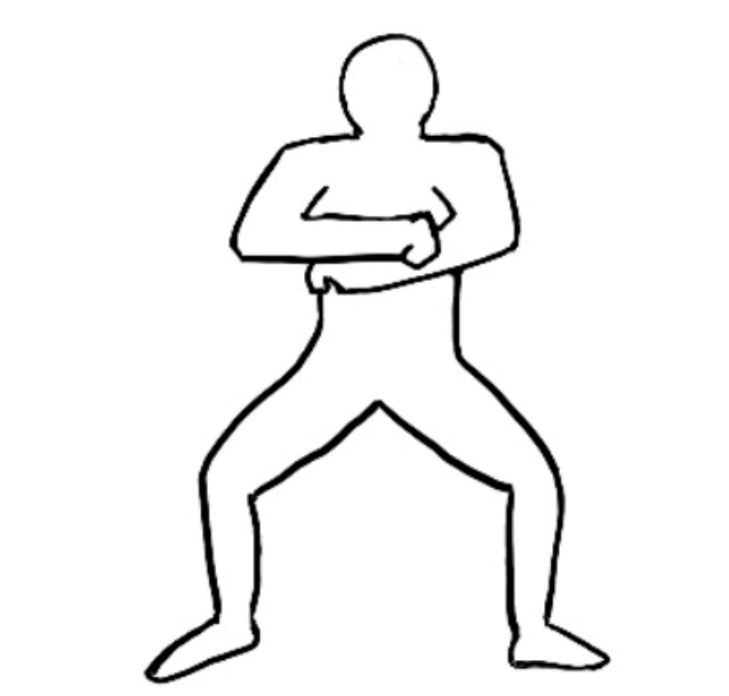

Slide 6
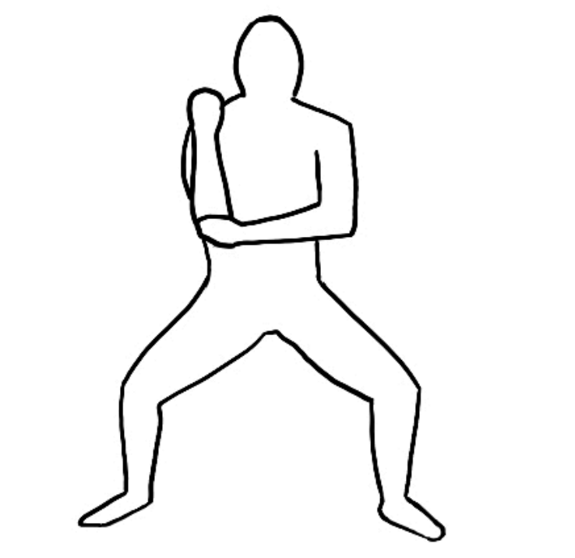

Slide 9
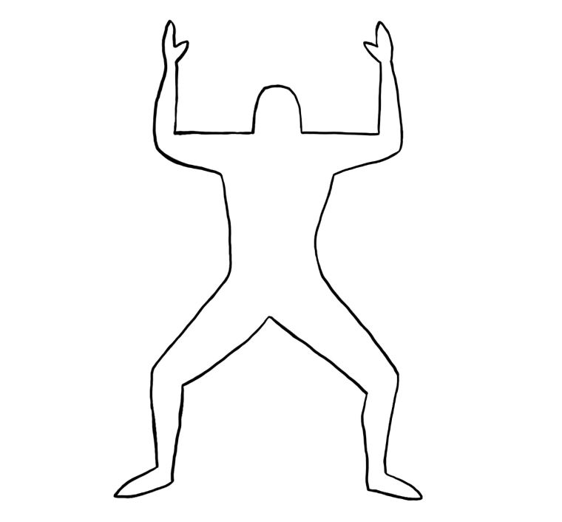

Slide 10
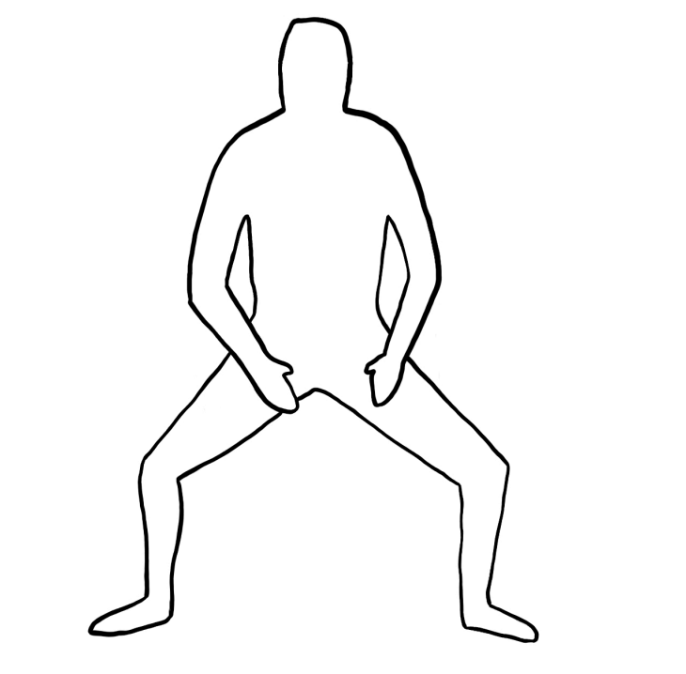
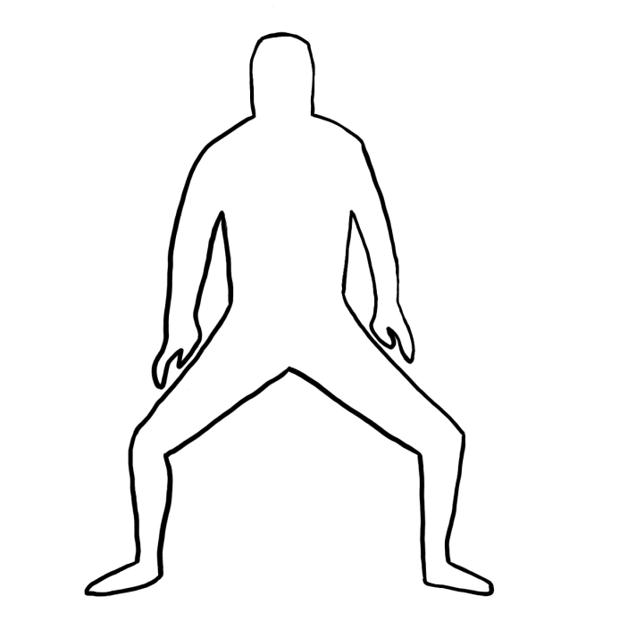

Slide 11
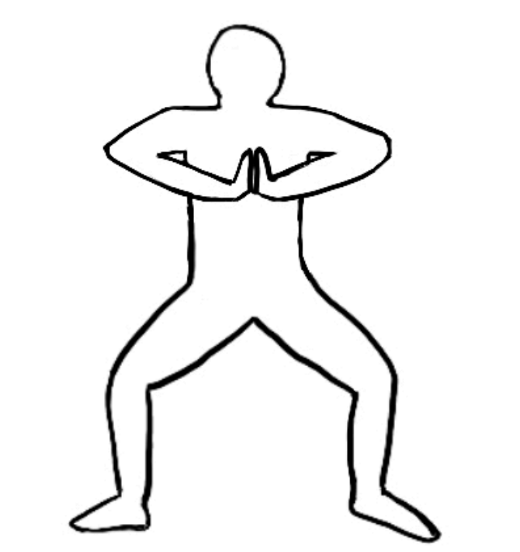
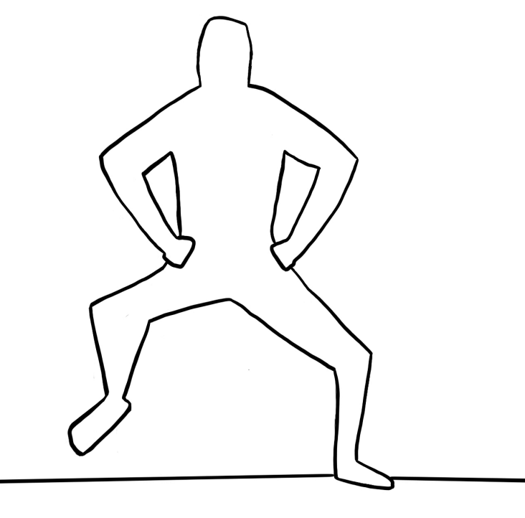

Slide 12
2

