Slide 1

He mana whenua,
he mana moana
ka kore e motu,
ka kore e mimiti i te wā

Slide 2
He mana whenua,
he mana moana
ka kore e mutu,
ka kore e memeha i te wā

Slide 3
He mana whenua,
he mana moana
ka kore e mutu,
ka kore e hātepe,
ka kore e tāharahara i te wā

Slide 4

Ko taku kāika,
ko Orariki

Slide 5

Taku pane ki uta,
aku waewae ki tai

Slide 6
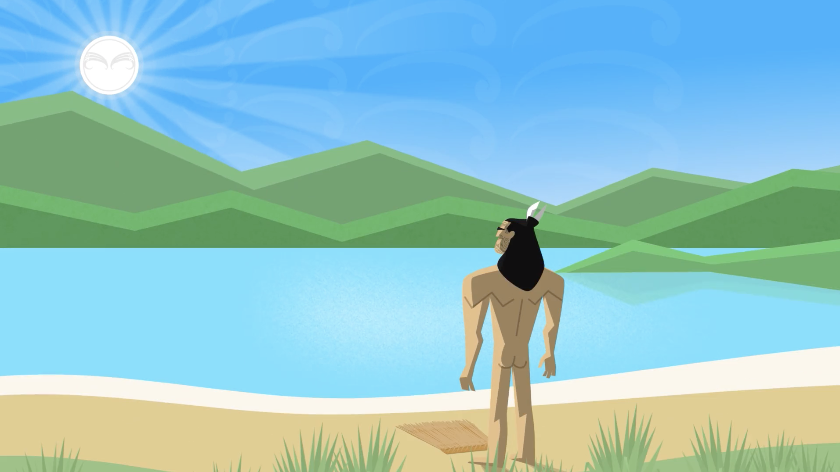
Te Rāpaki o Te Rakiwhakaputa

Slide 7
Inā te..
Inā te rahi
Inā te whānui

Slide 8
Mō te ….
kāre i tua atu
Mō te pātiki, kāre i tua atu

Slide 9
Tē
Tē huna atu te hīkaka

